Slide 1
Resource Allocation in Wireless Cellular Networks
M. Rasti
Amirkabir University of Technology

Slide 2
Course Syllabus
I- Basics of Wireless Networks
1- Introduction of Wireless Networks and Radio Resources
2- Categories of Wireless Networks and Taxonomy of Hot Topics Research Areas on Resource Allocation in Wireless Networks
II- Techniques for Modeling and Analysis of Radio Resource Allocation in Wireless Networks
3- Convex Optimization
4- Game Theory
III- Physical Layer Resource Allocation in Wireless Networks
5- General System Model and Preliminary Concepts
6- Power Control in Wireless Cellular Networks
7- Joint Power and Admission Control in Cellular Wireless Networks
8- Cell Association in Cellular Networks
9- Application of Game Theory in Physical Layer Resource Allocation in Wireless Networks
10- Joint Power and Admission Control in Cognitive Radio Network

Slide 3
Power Control in Wireless Cellular Networks Lecture 5 Outline
Performance Measures
Why Power Control?
Closed-Loop and Open-Loop Power Control
Different Power Control Optimization Problems
Distributed Power Control Algorithms
Some Open Problems

Slide 4
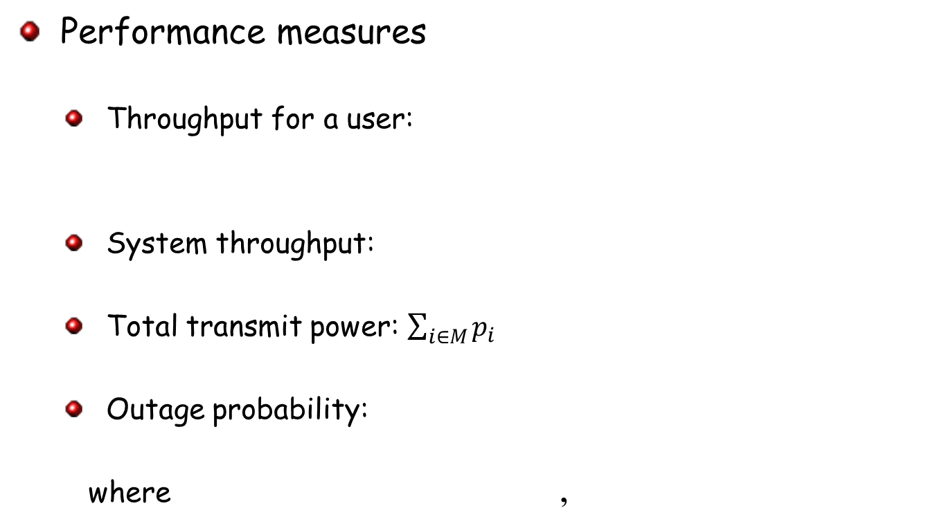
Performance Measures
Performance measures
Throughput for a user:
System throughput:
Total transmit power: $\sum_{i∈M}{p_{i}}$
Outage probability:
where ,

Slide 5
Power Control in Wireless Cellular Networks Lecture 5 Outline
Performance Measures
Why Power Control?
Closed-Loop and Open-Loop Power Control
Different Power Control Optimization Problems
Distributed Power Control Algorithms
Some Open Problems

Slide 6
Why Power Control? Need for Power Control
Power control is needed to resolve near-far problem
Objective of power control is to adjust the transmit power on the downlink and/or uplink in order to satisfy a given objective function
Minimizing total transmit power
Maximizing system throughput
Minimizing outage probability
Fairness

Slide 7
Uplink and Downlink Power Control
Power control is needed at both uplink and downlink
Most of the treatment is devoted to uplink transmission from mobile station (MS) to base station (BS), although extensions to downlink transmission from a BS to MSs are sometimes discussed as well
We focus on uplink power control

Slide 8
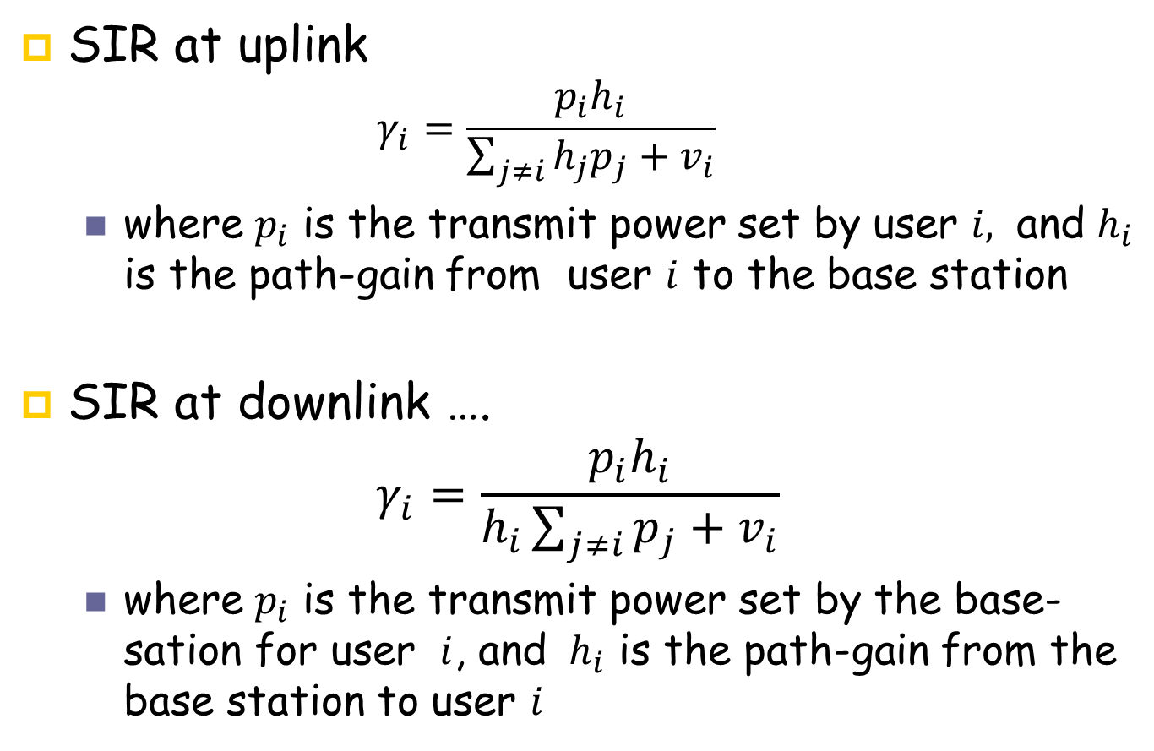
SIR at Downlink and Uplink
SIR at uplink
$$γ_{i}=\frac{p_{i}h_{i}}{\sum_{j≠i}{h_{j}p_{j}+v_{i}}}$$
where $p_{i}$ is the transmit power set by user $i,$ and $h_{i}$ is the path-gain from user $i$ to the base station
SIR at downlink ….
$$γ_{i}=\frac{p_{i}h_{i}}{h_{i}\sum_{j≠i}{p_{j}+v_{i}}}$$
where $p_{i}$ is the transmit power set by the base-sation for user $i$, and $h_{i}$ is the path-gain from the base station to user $i$

Slide 9
Why focusing on uplink power control?
In many formulations uplink problems are more difficult to solve, although there are exceptions like joint power control and beamforming
Uplink power control is also often more important in systems engineering of cellular networks
BS power consumption is of less importance in comparison to MS power consumption.
the downlink intra-cell interference is much smaller in comparison to uplink intra-cell interference, because maintaining orthogonality of resource allocation (e.g., code allocation in CDMA, tone allocation in OFDM) to MSs within a cell on the downlink is easily accomplished by the BS

Slide 10
Power Control in Wireless Cellular Networks Lecture 5 Outline
Performance Measures
Why Power Control?
Closed-Loop and Open-Loop Power Control
Different Power Control Optimization Problems
Distributed Power Control Algorithms
Some Open Problems

Slide 11
Existing Approaches for Power Control
Power Control
Non-cooperative
Cooperative
Game-theoretic
Centralized
Distributed

Slide 12
Conventional Centralized Uplink Power Control Schemes in Existing Standards
Open Loop
Base station transmits at a known power level (a beacon) which mobile measures to estimate the path loss
Assumes path loss in both directions is the same
Not very accurate when uplink and downlink are separated in frequency
Closed-Loop
SIR measured at the receiver and compared to the target-SIR value
Receiver sends a power control command to transmitter to reduce or increase the power level - requires a bidirectional link
CDMA2000: 800 commands/sec
3GPP: 1500 commands/sec

Slide 13
Uplink Open Loop Power Control
Key rule is that mobile transmits in inverse proportion to power level it receives from BS’s beacon
If the received power is high, the mobile user reduces its transmit power
If received power is low, mobile user increases its transmit power
In open loop power control the base station is not involved.

Slide 14
Flaw in Uplink Open Loop Power Control
Major flaw with this criteria is that uplink propagation statistics are based on downlink propagation statistics
But since the two links are not correlated a significant error may result from this procedure
These errors will be corrected once the closed loop power control mechanism becomes active
The closed loop power control provides correction to the open loop power control.

Slide 15
Close-Loop Power Control Properties
In closed-loop power control, based on power control bit received from the base station, mobile either increases or decreases transmit power
A zero indicates to the mobile that its should increase its mean output power level.
A one indicates to mobile to decrease its mean output power level.
Each power bit produces a 1db change in the power

Slide 16
PCGs
IN CDMA2000, a power control bit 0/1 is transmitted every 1.25 msec (800 power control bits per sec)
A 20ms frame is organized into 16 time intervals of equal durations
These time intervals, each of 1.25 ms are called power control groups (PCGs). Thus a frame has 16 PCGs.

Slide 17
Power Control in Wireless Cellular Networks Lecture 5 Outline
Performance Measures
Why Power Control?
Closed-Loop and Open-Loop Power Control
Different Power Control Optimization Problems
Distributed Power Control Algorithms
Some Open Problems

Slide 18
Possible Objective Functions in Power Control Problems….
Aggregate power consumption
Outage ratio
Sum rate (System Throughput)
Fairness
System Throughput and fairness
Notes:
Suppose tow transmit power vector and compare them based on above objective functions

Slide 19
Some Power Control Problems
Minimum aggregate power consumption subject to target-SIR
Minimum outage ratio
where

Slide 20
Some Power Control Problems
Maximizing aggregate SIR
Maximizing system throughput subject to a minimum target-SIR constraint

Slide 21
Some Power Control Problems
Max-min SIR (fairness)

Slide 22
Possible Objective Functions in Power Control Problems…
Suppose tow transmit power vector and compare them based on above objective functions
…..
Notes:
Suppose tow transmit power vector and compare them based on above objective functions

Slide 23
Power Control in Wireless Cellular Networks Lecture 5 Outline
Performance Measures
Why Power Control?
Closed-Loop and Open-Loop Power Control
Different Power Control Optimization Problems
Distributed Power Control Algorithms
Criteria for Evaluation and Analysis of Distributed Power Control
Convergence Analysis Framework for Distributed Power Control Algorithms
Existing Distributed Power Control Algorithms
Some Open Problems

Slide 24
Distributed Power Control Algorithms
Power updating function
Distributed unconstrained power control algorithm
Distributed constrained power control algorithm

Slide 25
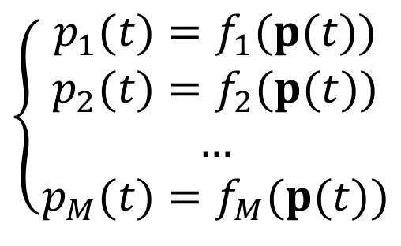
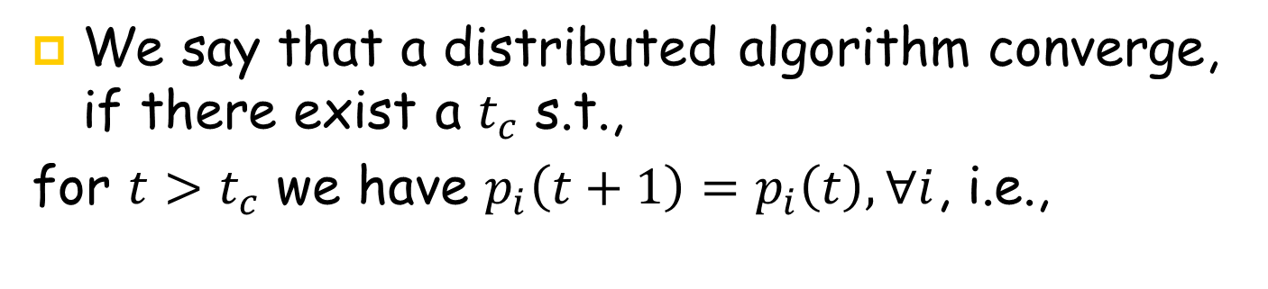
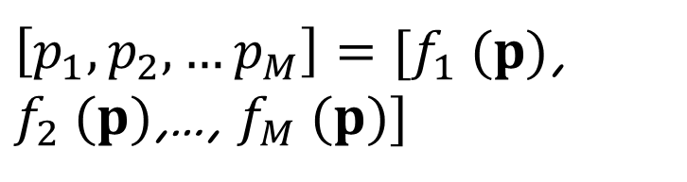

Distributed Power Control Algorithms
We say that a distributed algorithm converge, if there exist a $t_{c}$ s.t.,
for $t>t_{c}$ we have $p_{i}\left(t+1\right)=p_{i}\left(t\right), ∀i$, i.e.,
$$\left\{\begin{aligned}p_{1}(t)=f_{1}(p(t)) \\ p_{2}(t)=f_{2}(p(t)) \\ … \\ p_{M}(t)=f_{M}(p(t))\end{aligned}\right.$$
$\left[p_{1},p_{2},…p_{M}\right]=[f_{1} (p)$, $f_{2} (p)$,…, $f_{M} (p)]$
Fixed-Point
$$p=f (p)$$
Fixed-Point Equation:
Where may a distributed power control algorithm converge to? Fixed-Point(s)

Slide 26
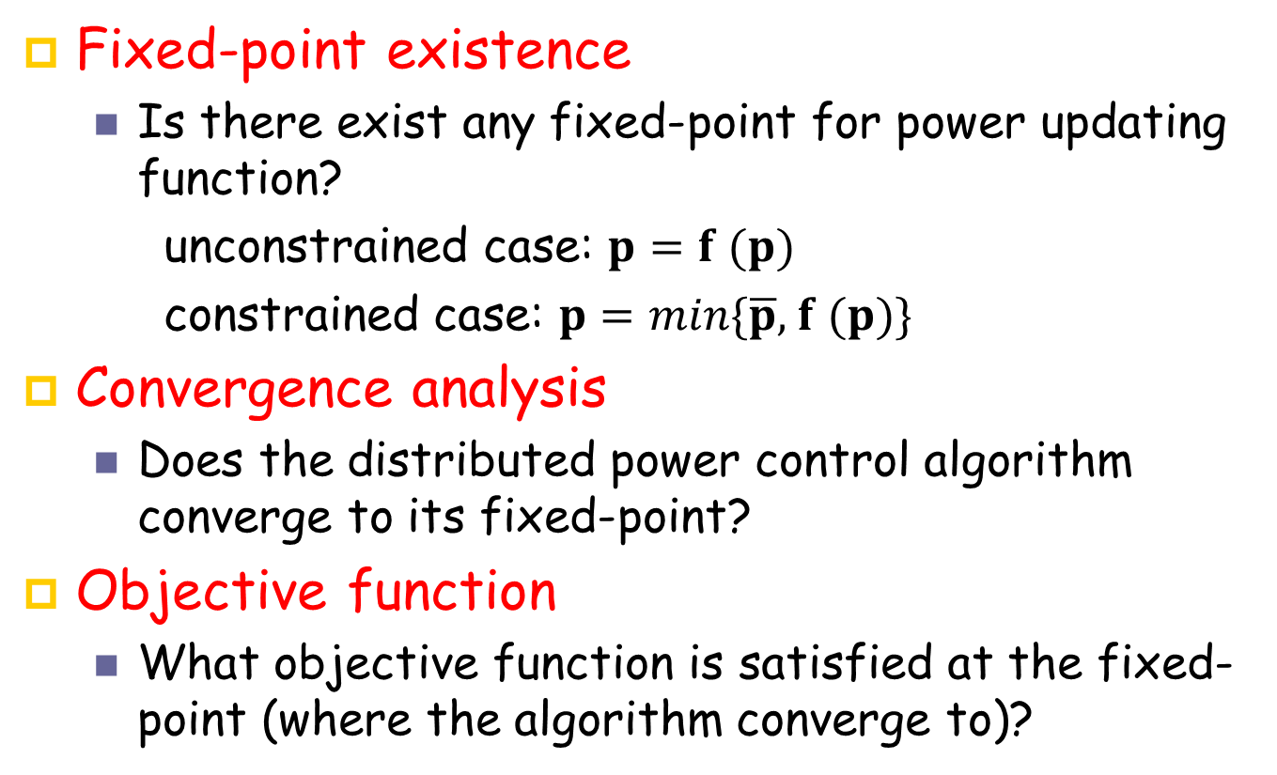
Distributed Power Control Algorithms- Analysis
Fixed-point existence
Is there exist any fixed-point for power updating function?
unconstrained case: $p=f (p)$
constrained case: $p=min${$\overline{p},$ $f (p)$}
Convergence analysis
Does the distributed power control algorithm converge to its fixed-point?
Objective function
What objective function is satisfied at the fixed-point (where the algorithm converge to)?
Notes:
In step 1 and 2 above, we obtain the fixed points using theoretical framework and in step 3 we investigate that the obtained fixed-point optimizes which objective function.

Slide 27
Distributed Power Control Algorithms- Analysis
Required information by each user to update its transmit power
Rate of convergence
Sensitivity analysis
Robust design

Slide 28
Power Control in Wireless Cellular Networks Lecture 5 Outline
Performance Measures
Why Power Control?
Closed-Loop and Open-Loop Power Control
Different Power Control Optimization Problems
Distributed Power Control Algorithms
Criteria for Evaluation and Analysis of Distributed Power Control
Convergence Analysis Framework for Distributed Power Control Algorithms
Existing Distributed Power Control Algorithms
Some Open Problems

Slide 29
Distributed Power Control (DPC)
Existing frameworks for fixed-point existence and convergence analysis
Existing DPC Algorithms (Objective functions, Required information by each user to update its transmit power, Rate of convergence, Sensitivity analysis)

Slide 30
Existing Theoretical Frameworks for Convergence Analysis of DPC Algorithms
Standard Type I
R. D. Yates, “A framework for uplink power control in cellular radio systems,” IEEE Journal on Selected Areas in Communications,1995.
Standard Type II
Generalized Framework
C. W. Sung and K. Leung, “A generalized framework for distributed power control in wireless networks,” IEEE Transactions on Information Theory, 2005.

Slide 31
Existing Distributed Power Control Algorithms
Existing DPC Algorithms
Target-SIR tracking power control (TPC)
Target-SIR tracking power control with permanent removal (TPC-PR)
Target-SIR tracking power control with temporary removal (TPC-TR)
Pareto and energy efficient target-SIR tracking with feasibility check (DFC)
Opportunistic power control (OPC)
Dynamic target-SIR tracking power control (DTPC)

Slide 32

Theoretical Frameworks for Convergence Analysis of DPC Algorithms
To study convergences of distributed power control algorithms, one may use one of three theoretical framework
Standard Type I (Yates, 1995)
Type-I monotonicity: if $p≤p′$ then $f(p)≤f(p′)$
Type-I scalability: for all $a>1$, $f(ap)<af(p)$
Standard Type II (Sung and Leung, 2005)
Type-II monotonicity: if $p≤p′$ then $f(p)≥f(p′)$
Type-II scalability: for all $a>1$, $f(ap)>{(1}/{a)}f(p)$
Generalized Framework (Sung and Leung, 2005)
Two sided scalability: for all $a>1$, ${(1}/{a)}p$ $≤p′≤ap$ implies ${(1}/{a)f(}p)$ $≤f(p^{′})≤af(p)$
TPC
OPC
TPC-SR, DTPC

Slide 33

Theoretical Frameworks for Convergence Analysis of DPC Algorithms
Wide-sense Standard: $f(p)$is said to be wide-sense standard if each of its components, is either standard type I or type II.
Theorem: A wide-sense standard function $f(p)$ is two-sided scalable.
The following example shows that the converse is not true. The iterative function
$$f\left(x\right)=\left\{\begin{aligned} \sqrt{x}, 0<x≤1 \\ \frac{1}{\sqrt{x}}, x>1\end{aligned}\right.$$
is a two sided scalable function. However it is neither standard type I nor type II, since the monotonicity properties do not hold.

Slide 34

Theoretical Frameworks for Convergence Analysis of DPC Algorithms
Given two iterative functions, $f\left(p\right)$ and $f′(p)$, define
$$f^{min}=min⁡\{f\left(p\right),f′(p)\}$$
and
$$f^{max}=max⁡\{f\left(p\right),f′(p)\}$$
where the minimum or maximum operation is applied component-wise.
Theorem: if $f\left(p\right)$ and $f′(p)$ are two-sided scalable functions, then $f^{min}$ and $f^{max}$ are also two-sided scalable functions.

Slide 35
Van diagram for these three framework
………..

Slide 36
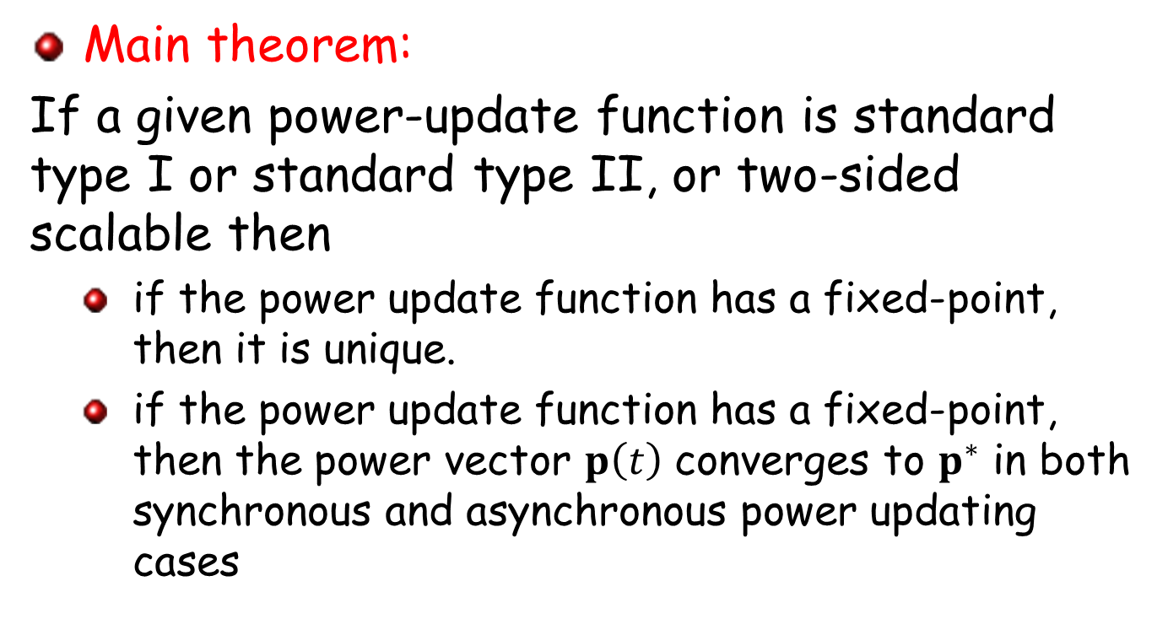
Theoretical Frameworks for Convergence Analysis of DPC Algorithms
Main theorem:
If a given power-update function is standard type I or standard type II, or two-sided scalable then
if the power update function has a fixed-point, then it is unique.
if the power update function has a fixed-point, then the power vector $p\left(t\right)$ converges to $p^{∗}$ in both synchronous and asynchronous power updating cases

Slide 37

Theoretical Frameworks for Convergence Analysis of DPC Algorithms
Main theorem:
Given a two sided scalable function, if there exists $l,u>o$ such that $l≤f(p)≤u$ for all $p$ then a fixed point exists

Slide 38
Power Control in Wireless Cellular Networks Lecture 5 Outline
Performance Measures
Why Power Control?
Closed-Loop and Open-Loop Power Control
Different Power Control Optimization Problems
Distributed Power Control Algorithms
Criteria for Evaluation and Analysis of Distributed Power Control
Convergence Analysis Framework for Distributed Power Control Algorithms
Existing Distributed Power Control Algorithms
Some Open Problems

Slide 39
Distributed Power Control (DPC)
Existing DPC Algorithms
Target-SIR tracking power control (TPC)
Target-SIR tracking power control with permanent removal (TPC-PR)
Target-SIR tracking power control with temporary removal (TPC-TR)
Pareto and energy efficient target-SIR tracking with feasibility check (DFC)
Opportunistic power control (OPC)
Dynamic target-SIR tracking power control (DTPC)

Slide 40
Power Control Papers-To be reviewed
Existing theoretical frameworks for convergence analysis
Standard Type I
R. D. Yates, “A framework for uplink power control in cellular radio systems,” IEEE Journal on Selected Areas in Communications,1995.
Generalized Framework
C. W. Sung and K. Leung, “A generalized framework for distributed power control in wireless networks,” IEEE Transactions on Information Theory, 2005.
Existing distributed power control algorithm
TPC
G. J. Foschini, and Z. Milijanic, “A simple distributed autonomous power control algorithm and its convergence,” IEEE Transactions on Vehicular Technology, 1993.
TPC-PR
M. Andersin, Z. Rosberg, and J. Zander, “Gradual removals in cellular PCS with constrained power control and noise," ACM/Baltzar Wireless Netw. J., 1996.

Slide 41
Power Control Papers-To be reviewed
TPC-TR
F. Berggren, R. Jantti, and S. Kim, “A generalized algorithm for constrained power control with capability of temporary removal,” IEEE Transactions on Vehicular Technology, 2001.
TPC-SR
M. Rasti and A. R. Sharafat, “Distributed power control with soft removal in wireless networks,” IEEE Transactions on Communications, 2011.
DFC
M. Rasti, A. R. Sharafat, and J. Zander, “A Distributed Pareto and energy efficient power control algorithm with Feasibility Check in wireless networks”, IEEE Transactions on Information Theory, 2010.

Slide 42
Power Control Papers-To be reviewed
OPC
K. Leung and C. W. Sung, “An opportunistic power control algorithm for cellular network,” IEEE/ACM Transaction on Networking, vol. 14, no. 3, pp. 470-478, June 2006.
DTPC
M. Rasti, A. R. Sharafat, and J. Zander, “A distributed dynamic target-SIR tracking power control algorithm for wireless cellular networks,” IEEE Transactions on Vehicular Technology, Feb. 2010.

Slide 43
Two Main Distributed Power Control Algorithm
DPC Algorithm | Optimization Problem (Objective Function) | Assumption
Target-SIR Tracking Power Control (TPC) | Minimum aggregate transmit power subject to users’ target-SIR | Each user has a target-SIR System is feasible
Opportunistic Power Control (OPC) | Maximum System throughput | No user has a predefined target-SIR

Slide 44
Distributed Power Control (DPC)
DPC Algorithm | Optimization Problem (Objective Function) | Assumption
Target-SIR Tracking Power Control (TPC) | Minimum aggregate transmit power subject to users’ target-SIR | Each user has a target-SIR System is feasible
TPC with Permanent Removal (TPC-PR) | Minimum outage ratio (to address gradual removal problem) | Each user has a target-SIR System is infeasible
TPC with Temporary Removal (TPC-TR)
TPC with soft removal (TPC-SR)
Pareto and energy efficient target-SIR tracking with feasibility check (DFC)
Opportunistic Power Control (OPC) | Maximum System throughput | No user has a predefined target-SIR
Dynamic target-SIR tracking power control (DTPC) | Maximum System throughput subject to a minimum target-SIR constraint | Each user has a target-SIR

Slide 45
Lecture 5 Outline
Existing Distributed Power Control Algorithms
TPC,TPC-PR,TPC-TR, TPC-SR, DFC
OPC, DTPC

Slide 46
Target-SIR Tracking Power Control (TPC)
Corresponding Optimization Problem:
Minimum aggregate power consumption subject to target-SIR

Slide 47
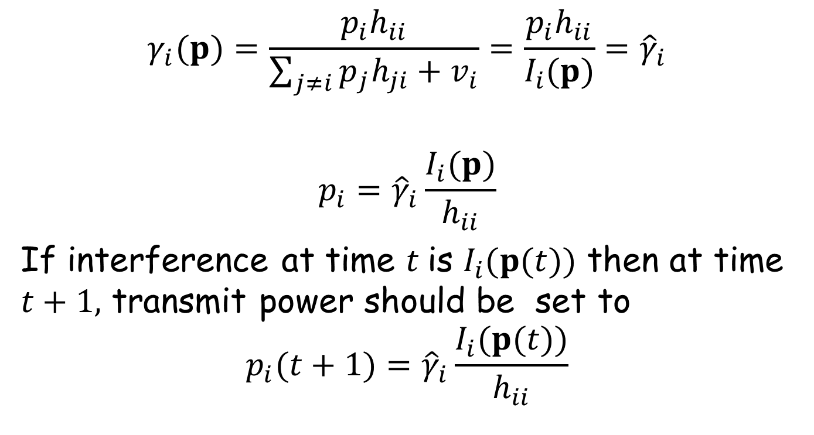
Target-SIR Tracking Power Control (TPC)
$$γ_{i}(p)=\frac{p_{i}h_{ii}}{\sum_{j≠i}{p_{j}h_{ji}+v_{i}}}=\frac{p_{i}h_{ii}}{I_{i}(p)}{=\hat{γ}}_{i}$$
$$p_{i}={\hat{γ}}_{i}\frac{I_{i}(p)}{h_{ii}}$$
If interference at time $t$is $I_{i}(p(t))$ then at time $t+1,$ transmit power should be set to
$$p_{i}(t+1)={\hat{γ}}_{i}\frac{I_{i}(p(t))}{h_{ii}}$$

Slide 48


Target-SIR Tracking Power Control (TPC)
Unconstrained TPC:$p_{i}\left(t+1\right)={\hat{γ}}_{i}\frac{I_{i}\left(p\left(t\right)\right)}{h_{ii}}$
Constrained TPC:$p_{i}\left(t+1\right)=min\{{\overline{p}}_{i},{\hat{γ}}_{i}\frac{I_{i}\left(p\left(t\right)\right)}{h_{ii}}\}$
p_{i}
$${\overline{p}}_{i}$$
TPC
R_{i}

Slide 49
Target-SIR Tracking Power Control (TPC)- Analysis
Q: Check if TPC power update function is a type-I or type-II standard or two-sided scalable function ?
Fixed-point existence
TPC power update function is a type I standard function
Notes:
In step 1 and 2 above, we obtain the fixed points using theoretical framework and in step 3 we investigate that the obtained fixed-point optimizes which objective function.

Slide 50
Target-SIR Tracking Power Control (TPC)- Analysis
Fixed-point existence
Unconstrained TPC:
There exist a unique fixed-point when the system is feasible
There is no fixed-point for TPC power update function when the system is infeasible.
Constrained TPC
There exist a unique fixed-point in both feasible and infeasible systems.
Notes:
In step 1 and 2 above, we obtain the fixed points using theoretical framework and in step 3 we investigate that the obtained fixed-point optimizes which objective function.

Slide 51
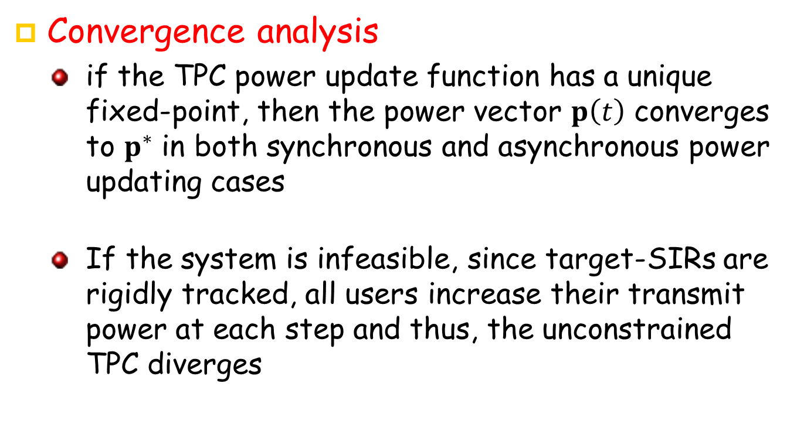
Target-SIR Tracking Power Control (TPC)- Analysis
Convergence analysis
if the TPC power update function has a unique fixed-point, then the power vector $p\left(t\right)$ converges to $p^{∗}$ in both synchronous and asynchronous power updating cases
If the system is infeasible, since target-SIRs are rigidly tracked, all users increase their transmit power at each step and thus, the unconstrained TPC diverges
Notes:
In step 1 and 2 above, we obtain the fixed points using theoretical framework and in step 3 we investigate that the obtained fixed-point optimizes which objective function.

Slide 52
Target-SIR Tracking Power Control (TPC)- Analysis
Objective function
If the system is feasible, TPC solves the following optimization in a distributed manner.
Notes:
In step 1 and 2 above, we obtain the fixed points using theoretical framework and in step 3 we investigate that the obtained fixed-point optimizes which objective function.

Slide 53
Distributed Power Control Algorithms- Analysis
Required information by each user to update its transmit power
Rate of convergence
Sensitivity analysis
Robust design

Slide 54
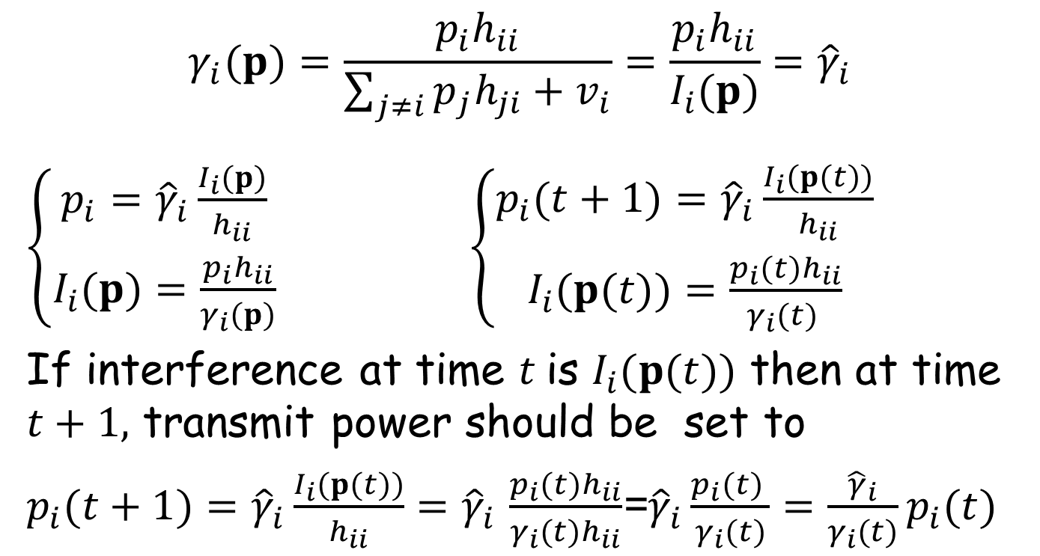
Target-SIR Tracking Power Control (TPC)
$$γ_{i}(p)=\frac{p_{i}h_{ii}}{\sum_{j≠i}{p_{j}h_{ji}+v_{i}}}=\frac{p_{i}h_{ii}}{I_{i}(p)}{=\hat{γ}}_{i}$$
$\left\{\begin{aligned}p_{i}={\hat{γ}}_{i}\frac{I_{i}(p)}{h_{ii}} \\ I_{i}(p)=\frac{p_{i}h_{ii}}{γ_{i}(p)}\end{aligned}\right.$ $\left\{\begin{aligned}p_{i}(t+1)={\hat{γ}}_{i}\frac{I_{i}(p(t))}{h_{ii}} \\ I_{i}(p(t))=\frac{p_{i}(t)h_{ii}}{γ_{i}(t) }\end{aligned}\right.$
If interference at time $t$is $I_{i}(p(t))$ then at time $t+1,$ transmit power should be set to
$p_{i}(t+1)={\hat{γ}}_{i}\frac{I_{i}(p(t))}{h_{ii}}{=\hat{γ}}_{i}\frac{p_{i}(t)h_{ii}}{γ_{i}(t)h_{ii}}$=${\hat{γ}}_{i}\frac{p_{i}(t) }{γ_{i}(t)}=\frac{{\hat{γ}}_{i}}{γ_{i}(t)}p_{i}(t)$
Notes:
Another way of reducing required information is that the total received from all users is broadcasted by base station to users.

Slide 55

Target-SIR Tracking Power Control (TPC)
TPC Power Updating Function
$p_{i}(t+1)={\hat{γ}}_{i}\frac{I_{i}(p(t))}{h_{ii}}$
or equivalently
$$p_{i}(t+1)=\frac{{\hat{γ}}_{i}}{γ_{i}(t)}p_{i}(t)$$

Slide 56
Distributed Target-SIR Tracking Power Control (TPC)
Unconstrained TPC:
Constrained-TPC
TPC and Closed-Loop-based power control is equivalent
p_{i}
TPC
R_{i}

Slide 57
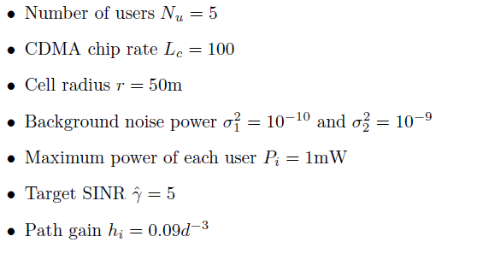

Numerical Results
TPC in a 5-users system

Slide 58
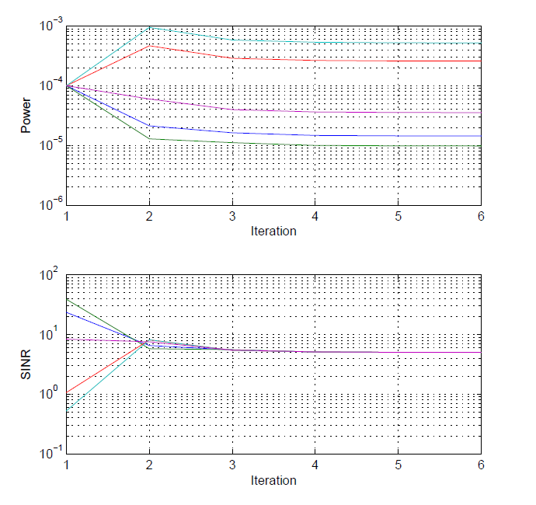
Numerical Results: Constrained TPC in feasible System

Slide 59
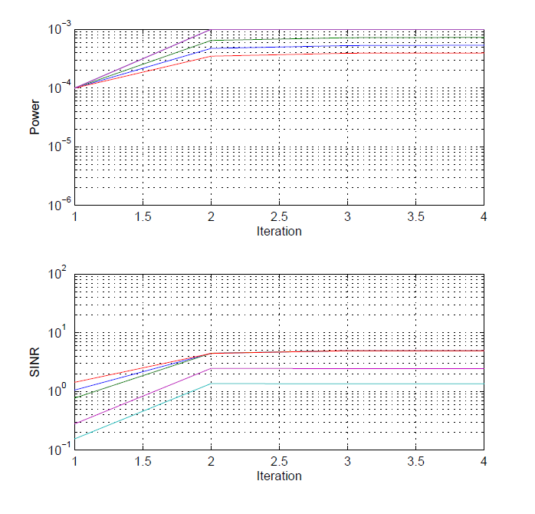
Numerical Results: Constrained TPC in Infeasible System

Slide 60
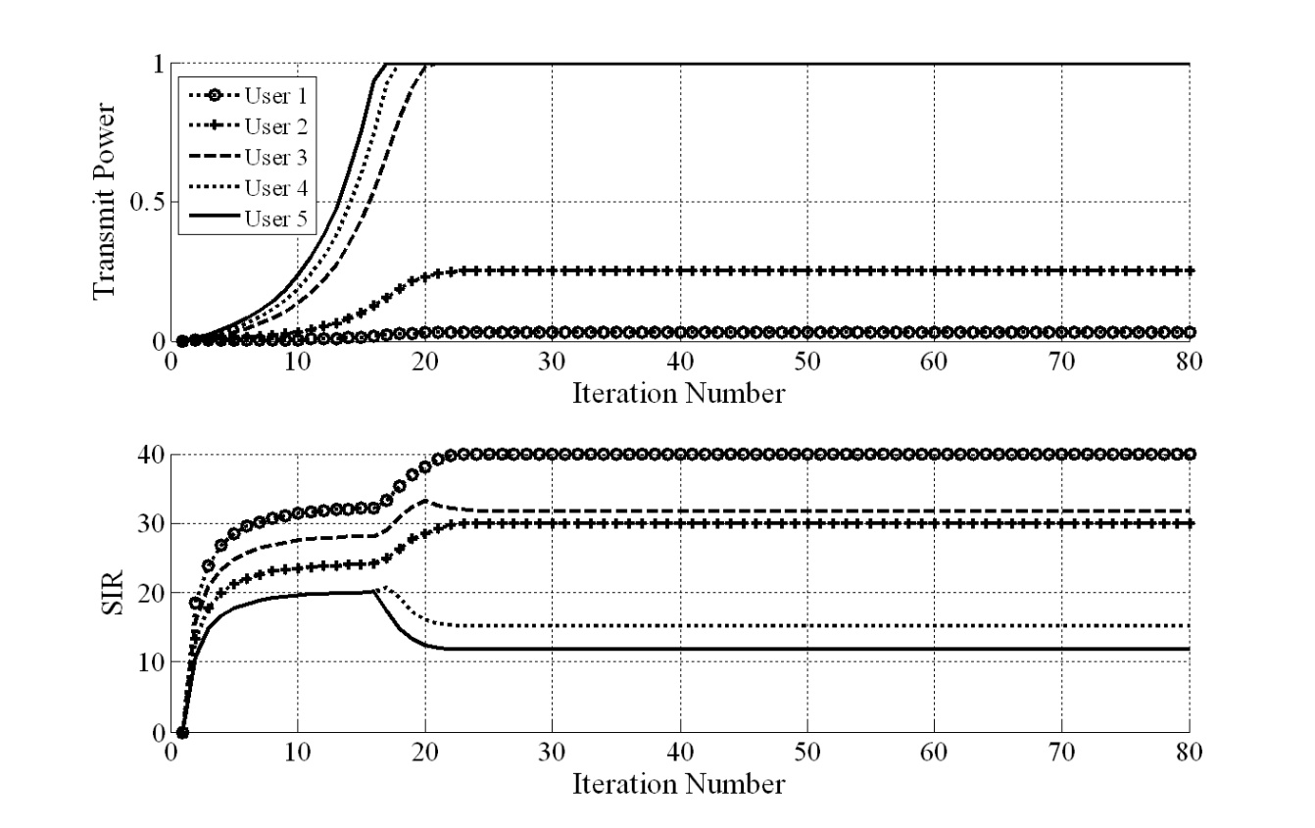
Numerical Results: Constrained TPC in Infeasible System
TPC

Slide 61
Drawbacks of TPC
If the target-SIRs are not attainable, the conventional TPC or closed-loop based power control algorithms results in an maximum transmission by all non-supported users
inefficient power consumption
increased number of non-supported users
A Straightforward Solution
All non-supported users are removed (too many unnecessary removals!), which is currently implemented in existing (closed-loop based) standards
Gradual Removal Problem

Slide 62
Drawbacks of TPC
Gradual Removal Problem
Designing a (centralized or distributed) mechanism to check the feasibility
When the system is infeasible, least number of users should be temporarily removed
Gradual removal problem is a NP-hard problem
There exits no power control scheme (whether distributed or centralized) with capabilities of gradual removal and feasibility check

Slide 63
The Problem Statement
Gradual Removal Algorithm
Designing a distributed mechanism to check the feasibility
When the system is infeasible, least number of users should be temporarily removed

Slide 64
Gradual Removal Problem: Motivating Example
Consider 4 users whose path-gains are given by
and noise plus inter-cell interference is . By running the TPC or equivalently the closed-loop power control, for the target-SIR vector of , the following results are obtained.
Received SIR/Tranmit Power
 | 1 | 0
 | 1 | 0.75
 | 1 | 0.70
 | 0.73 | 0.50
Users 1 to 3 transmit at their maximum power without reaching their target-SIR
If users 1 is removed, then the remaining users reach their target-SIR consuming less power

Slide 65
Existing Gradual Removal Algorithms
DPC Algorithm | Optimization Problem (Objective Function) | Assumption
Target-SIR Tracking Power Control (TPC) | Minimum aggregate transmit power subject to users’ target-SIR | Each user has a target-SIR System is feasible
TPC with Permanent Removal (TPC-PR) | Minimum outage ratio (to address gradual removal problem) | Each user has a target-SIR System is infeasible
TPC with Temporary Removal (TPC-TR)
TPC with soft removal (TPC-SR)
Pareto and energy efficient target-SIR tracking with feasibility check (DFC)

Slide 66
Lecture 5 Outline
Existing Distributed Power Control Algorithms
TPC,TPC-PR,TPC-TR, TPC-SR, DFC
OPC, DTPC

